Slide 1
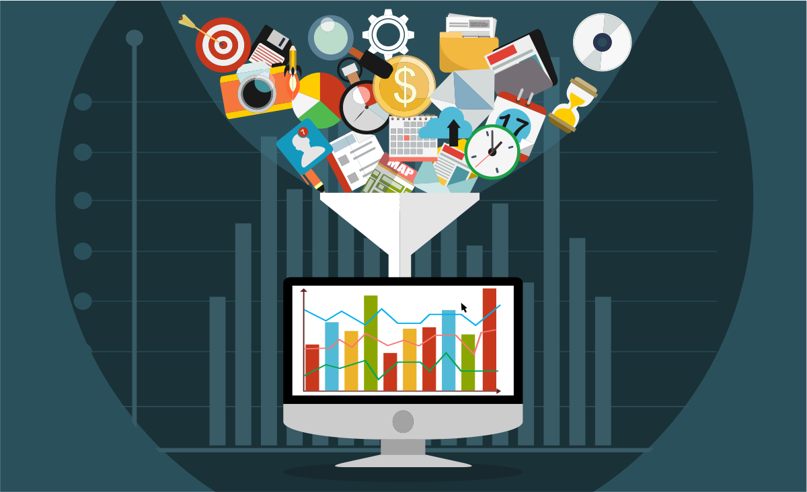





Movie Recommendation Website
Arun Vemireddy
A02370352
Intro to Data Analysis – CS 6890-002

Slide 2
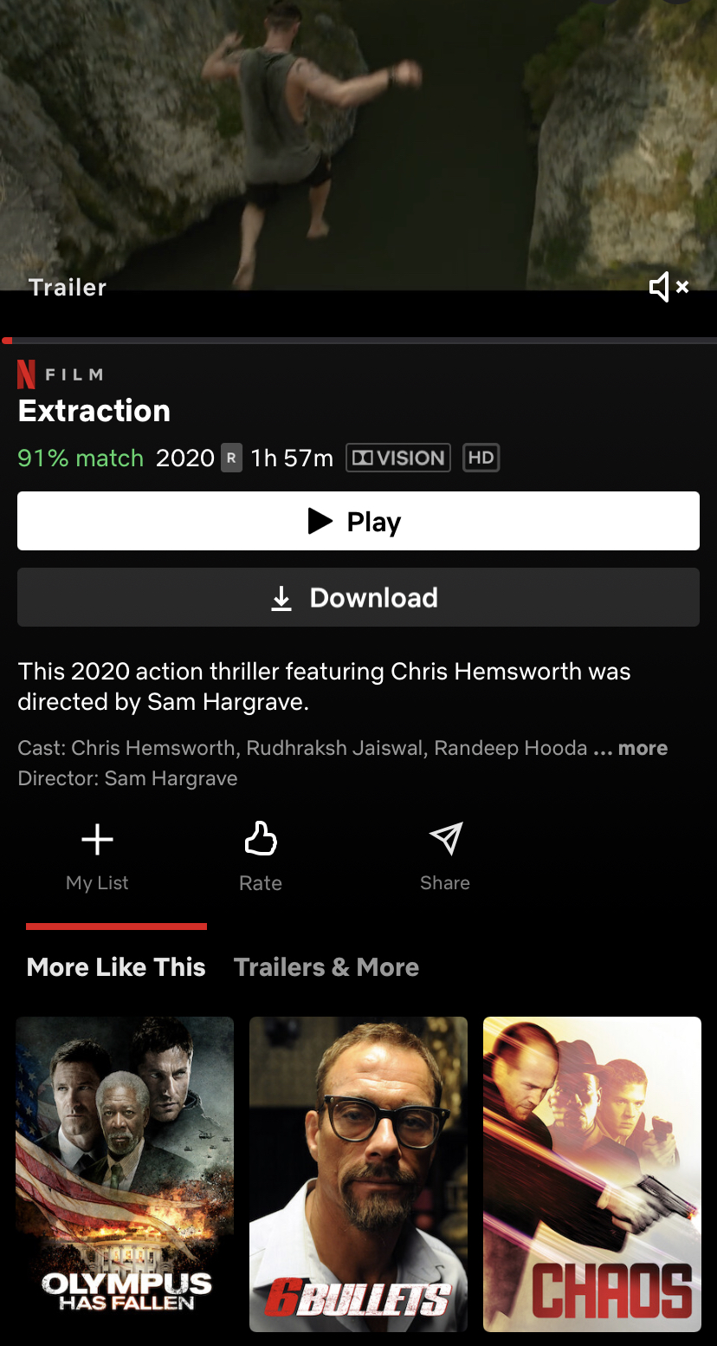
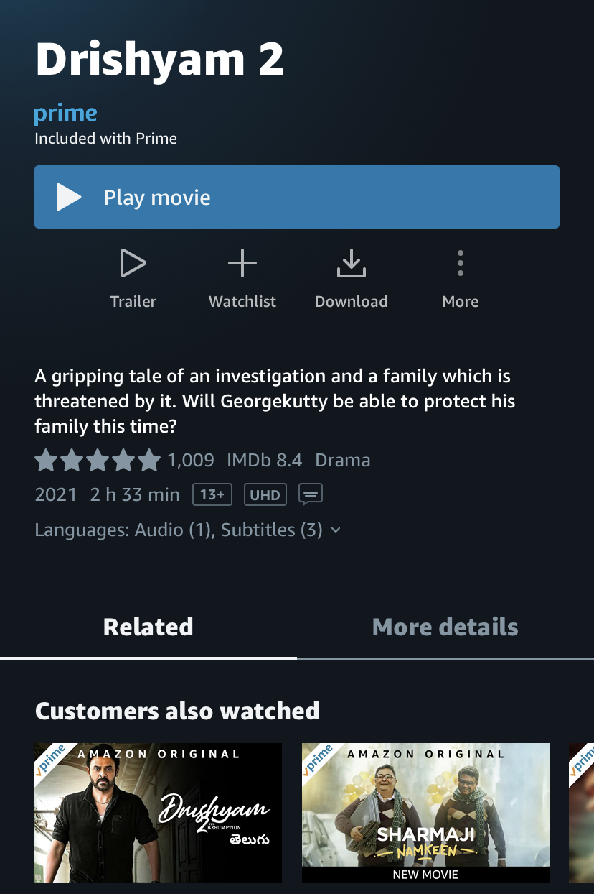
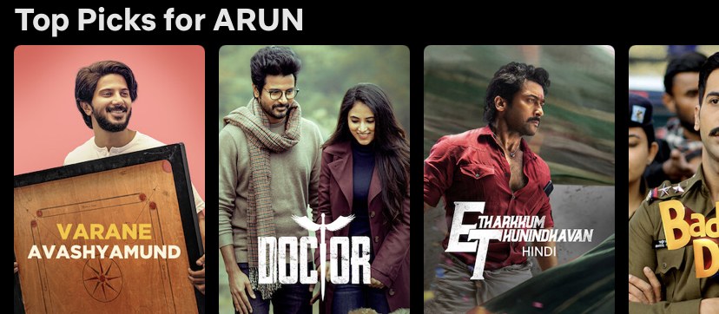
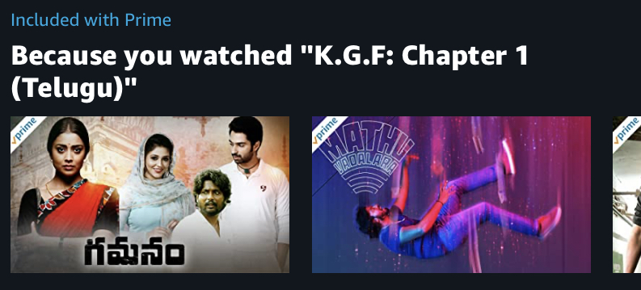
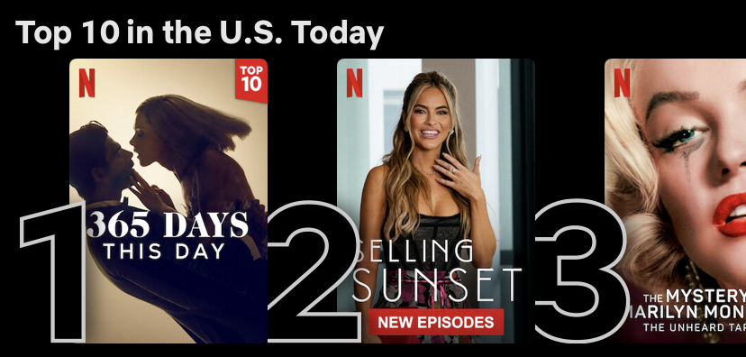
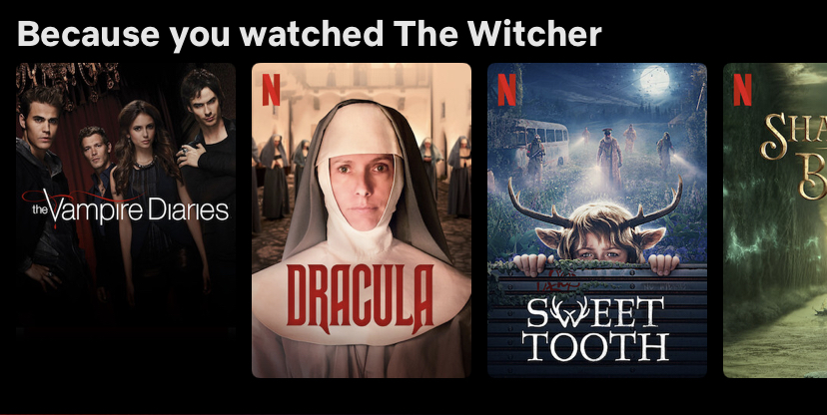
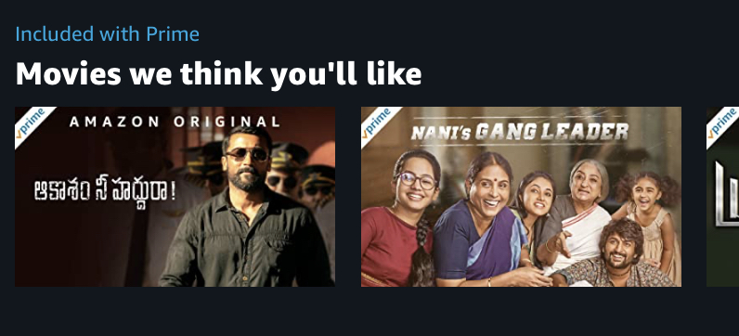
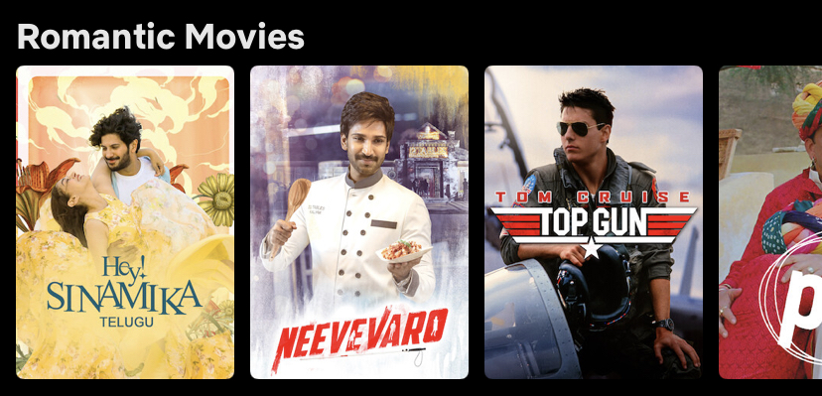
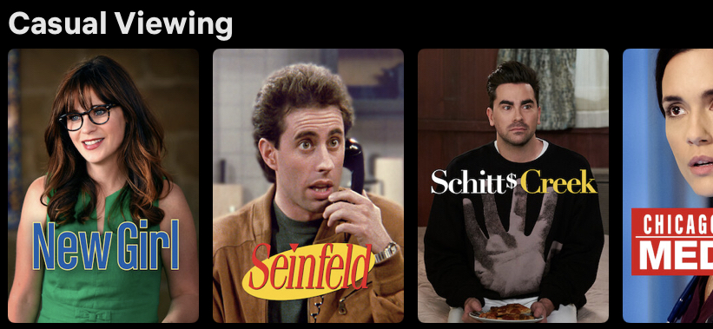
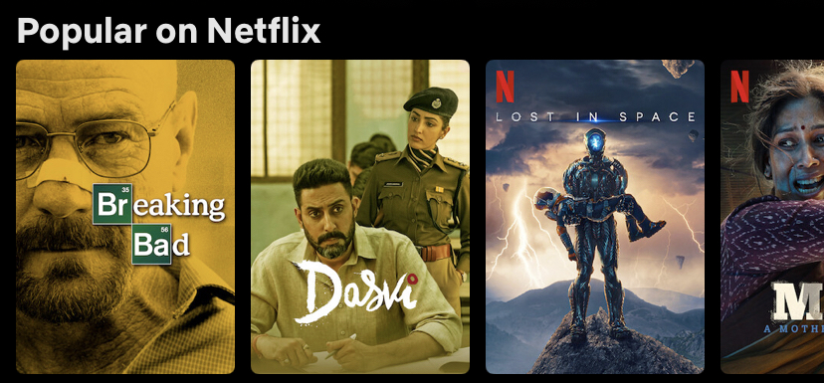
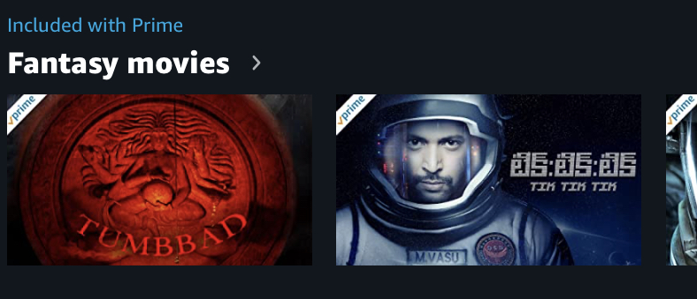

Slide 3



Agenda
Apply User / Item based recommendation algorithm
Develop Web based Interface

Slide 4

Introduction
Movie Recommendation algorithms are mainly used in the platforms like Prime, Disney, Hulu etc. These algorithms suggest content based on user taste.
In this project I have built content recommendation website that recommends content based on content metadata and user taste.
In the following slides I will discuss more about system design, Implementation and methodologies/techniques used for building this website

Slide 5




System Design
Frontend
Backend
Database
Request(GET,POST)
Request
Response(json)
Response

Slide 6

Libraries used for this project
sklearn knn cosine_similarity CountVectorizer
Numpy
Pandas
Scipy
ast

Slide 7
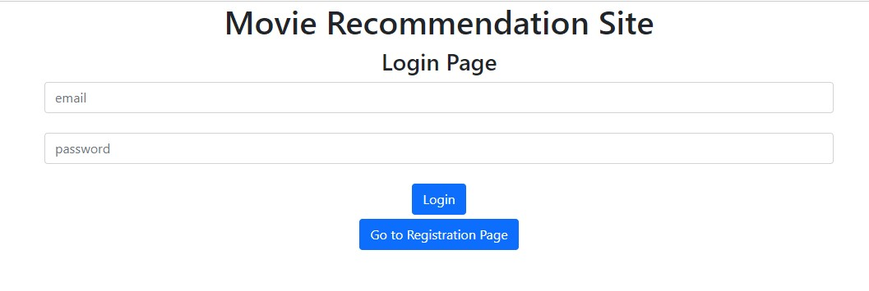
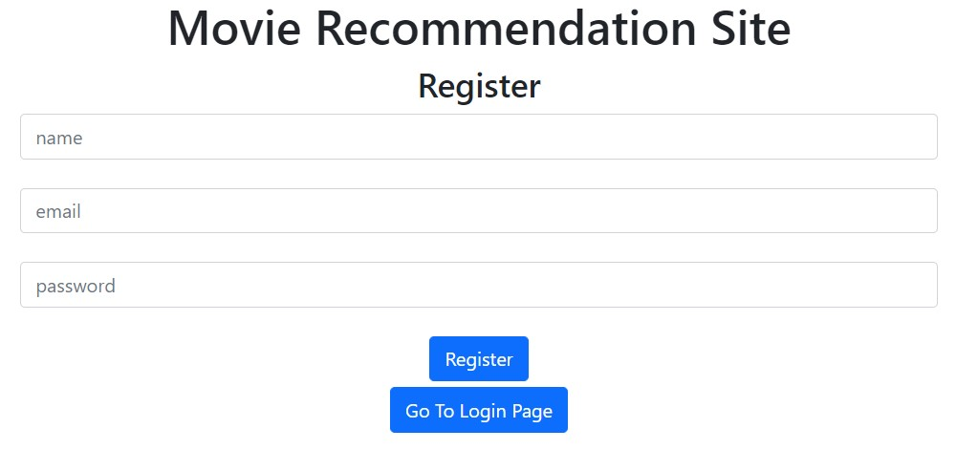
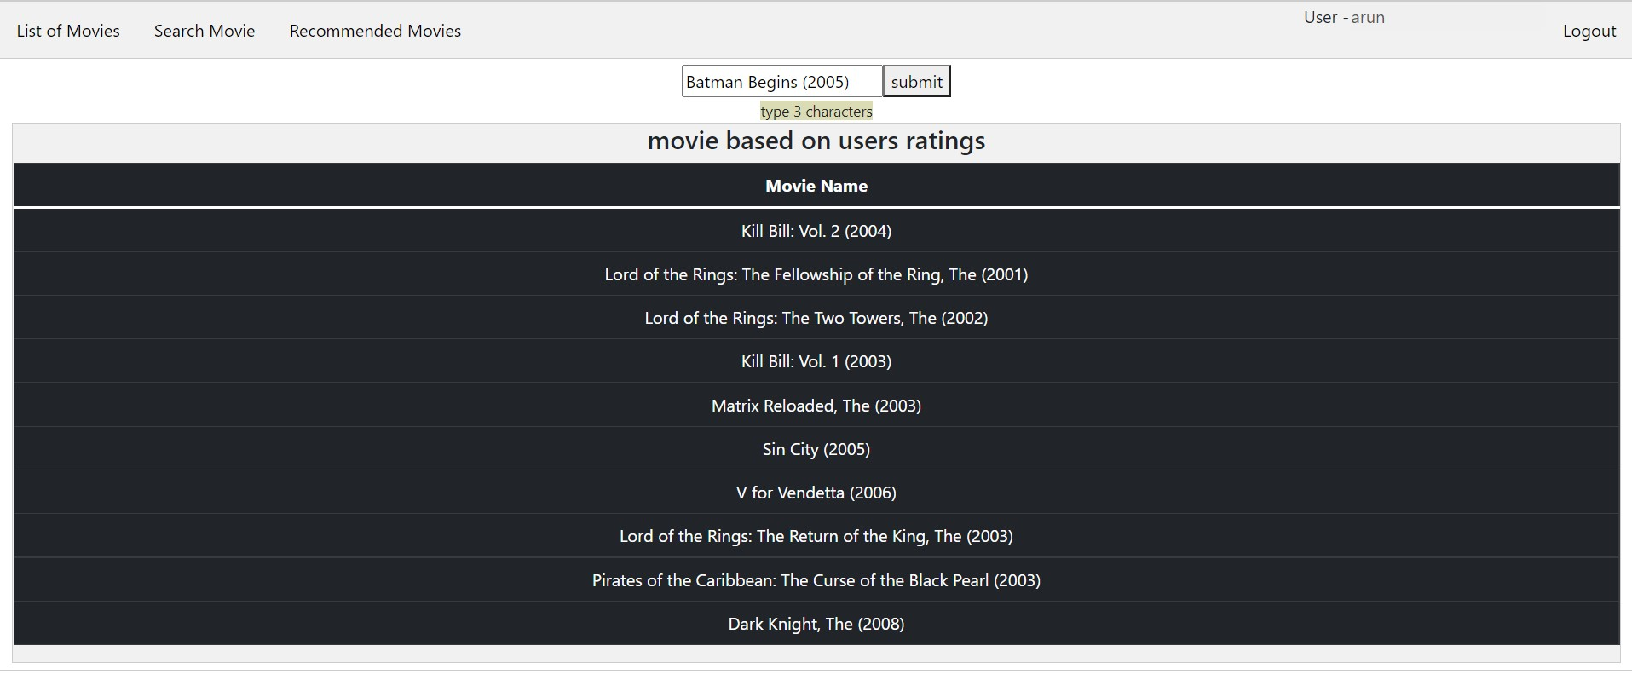
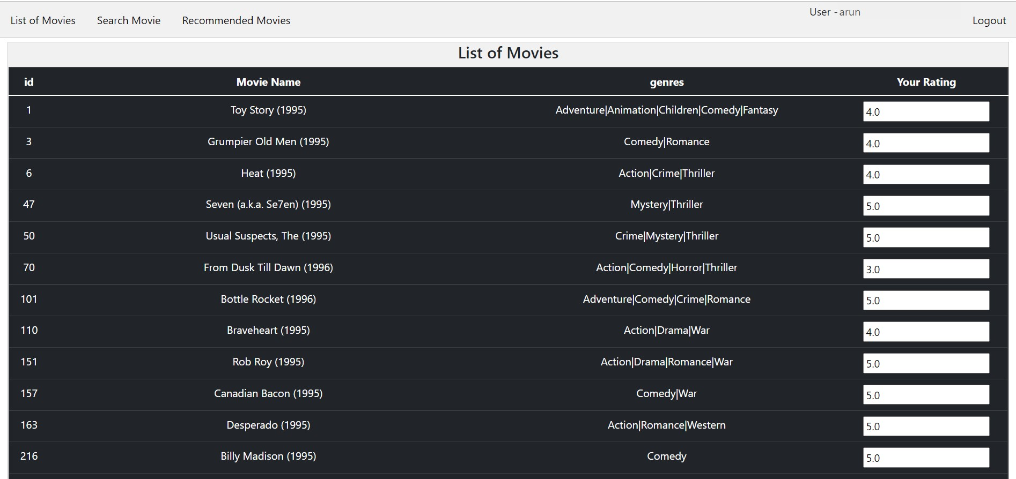
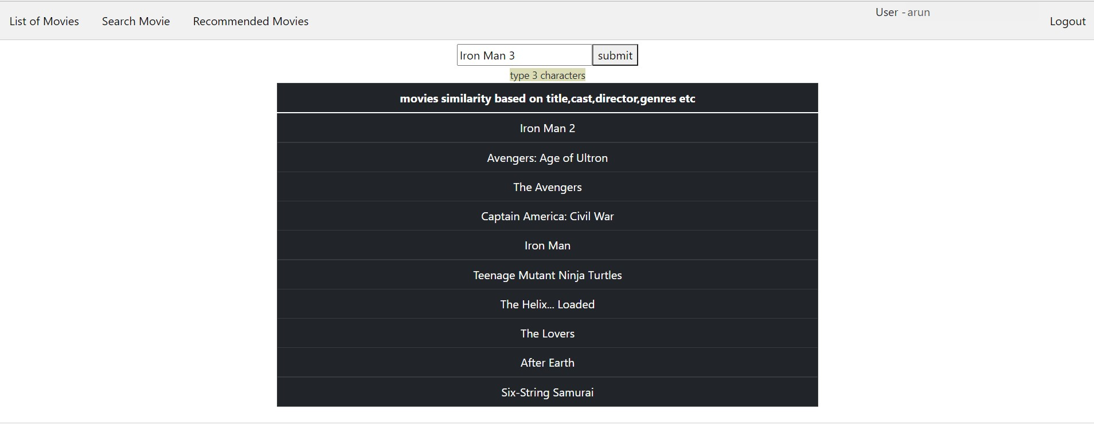

Slide 9
CHALLENGES
Working with Tensorflow, Keras
Memory Issues
Fixing bugs
WHAT I LEARNED
Build website from scratch
Clustering Algorithms
How recommendation systems like Netflix, Prime.. Works
Django rest framework, React
Machine Learning Algorithms like scikit-learn
How to train a model,

Slide 11


Thank You
Arun
a02370352@usu.edu
bitbucket.org/Arun_Vemireddy/project/src/master/

Slide 12
Char

Slide 13
Table
 | Category 1 | Category 2 | Category 3 | Category 4
Item 1 | 4.5 | 2.3 | 1.7 | 5
Item 2 | 3.2 | 5.1 | 4.4 | 3
Item 3 | 2.1 | 1.7 | 2.5 | 2.8
Item 4 | 4.5 | 2.2 | 1.7 | 7

Slide 14




Team
Name
Name
Name
Name
Title
Title
Title
Title

Slide 15
Timeline
Title
To start a presentation, go to the Slide Show tab, and select From Beginning.
Title
To display Presenter view, in Slide Show view, on the control bar at the bottom left select the three dots, and then Show Presenter View.
Title
During your presentation, the speaker notes are visible on your monitor, but aren't visible to the audience.
Title
Title
If you don’t see the Notes pane or it is completely minimized, click Notes on the task bar across the bottom of the PowerPoint window.
The Notes pane is a box that appears below each slide. Tap it to add notes.

Slide 16
Content
Subtitle
Subtitle
Add text, images, art, and videos.
Add transitions, animations, and motion.
Save to OneDrive, to get to your presentations from your computer, tablet, or phone.
Open the Design Ideas pane for instant slide makeovers.
When we have design ideas, we’ll show them to you right there.

Slide 17
Content 2
Subtitle
subtitle
subtitle
Add text, images, art, and videos.
Add transitions, animations, and motion.
Save to OneDrive, to get to your presentations from your computer, tablet, or phone.
Open the Design Ideas pane for instant slide makeovers.
When we have design ideas, we’ll show them to you right there.
Add text, images, art, and videos.
Add transitions, animations, and motion.
Save to OneDrive, to get to your presentations from your computer, tablet, or phone.
Open the Design Ideas pane for instant slide makeovers.
When we have design ideas, we’ll show them to you right there.
Add text, images, art, and videos.
Add transitions, animations, and motion.
Save to OneDrive, to get to your presentations from your computer, tablet, or phone.
Open the Design Ideas pane for instant slide makeovers.
When we have design ideas, we’ll show them to you right there.

Slide 18

Summary
With PowerPoint, you can create presentations and share your work with others, wherever they are. Type the text you want here to get started. You can also add images, art, and videos on this template. Save to OneDrive and access your presentations from your computer, tablet, or phone.

